Slide 1


INTRODUCTION
To Security
A Course Designed Specifically for FDIC Risk Management Examiners
Copyright Hill Associates

Slide 2
Getting Started
Please comment, feed back, and advise.
  We’re very interested in your ideas, thoughts, and feelings about this course, the method, and the material itself.
  You can get to us any way you like: Email to matt@hillvt.com, or written/oral comments to me.

Slide 3
Introductions
Please tell us about you!
  Where do you live and work?
  What’s your role?
  What do you do for fun?
  What would you like to take away from this course?

Slide 4
Program Introduction
Chapter 1

Slide 5
Overall Goals
Understand the big-picture Information Security (InfoSec) concepts and apply them to banking situations
Focus on cybersecurity and resilience
Gain an understanding of the underlying relationships between interconnecting concepts related to risk management and information security
Get a handle on the terminology
Have fun

Slide 6
Specific Course Objectives
Explain Information Security using baseline terminology and concepts
Describe regulatory guidance related to information security
Discuss security policy design and implementation
Explain the role of bank management and oversight responsibilities
Discuss security management practices
Describe physical and operations security

Slide 7
Specific Course Objectives (continued)
Explain network controls testing, auditing, and monitoring
Describe secure network design, encryption, access control, and authentication
Discuss firewall implementation and concepts
Describe vendor management security
Explain basic types of security issues and mitigation strategies

Slide 8
Some Security Predictions for 2026
AI is the hot topic for attack, defense and new risks
Stolen credentials will become primary entry point to corporate networks
Ransomware will continue to evolve
Geopolitical attacks will continue to grow disrupting global stability
Identity and access management become a major focus
Supply chain attacks and third-party risks increase as reliance on IT and outsourcing increase
Time for post quantum encryption

Slide 9
Exercise
At your table discuss the major cybersecurity threats you are concerned about and create a list of your top 3 concerns. Your concerns maybe related to banking, general business, society, personal or the nation.

Slide 10


Information Security Introduction
Chapter 2

Slide 11
Objectives
Upon completing this chapter, you will be able to
Define Information Security
Compare Information Security and Cybersecurity
Describe what we are protecting
List the elements of an Information Security Plan
Identify the Information Security Requirements and Resources for banks

Slide 12
Information Security
Like corporate security, or quality assurance within
manufacturing, it is a process, not a one-time implementation
To mitigate risk, plan for an “event”
Requires the integration of people, processes and technology
Events consistently have shown it is hard, but necessary
Security strategies should include
prevention, detection, and response
People
Process
Technology

Slide 13
Information Security: Part 364 Appendix B
Information security is the process by which a financial institution protects the creation, collection, storage, use, transmission, and disposal of sensitive information, including the protection of hardware and infrastructure used to store and transmit such information
Information security exists to provide protection from malicious and non-malicious actions that increase the risk of adverse effects on earnings, capital, or enterprise value
Goal is to prevent:
  Disclosure of information to unauthorized individuals
  Unavailability or degradation of services
  Misappropriation or theft of information or services
  Modification or destruction of systems or information
  Records that are not timely, accurate, complete, or consistent

Slide 14
Cyber Security or Cybersecurity
Is a subset of Information Security protecting digital assets from cyber attacks
Area of growing concern as more assets become digital and threats increase
FDIC has increased focus on cybersecurity in recent years
  NIST Cybersecurity framework
Part of the overall Information Security Plan

Slide 15

Remember the Information Security Triad from ITEC?
Integrity
Confidentiality
Availability

Slide 16
Information Security Program
Part 364 Appendix B states each institution must:
  Design its information security program to control the identified risks
  Consider whether the following security measures are appropriate for the institution and, if so, adopt those measures the institution concludes are appropriate
Complexity of the Information Security program will vary based on:
  Sensitivity of the information
  Scope of institution services
  Size of the institution

Slide 17
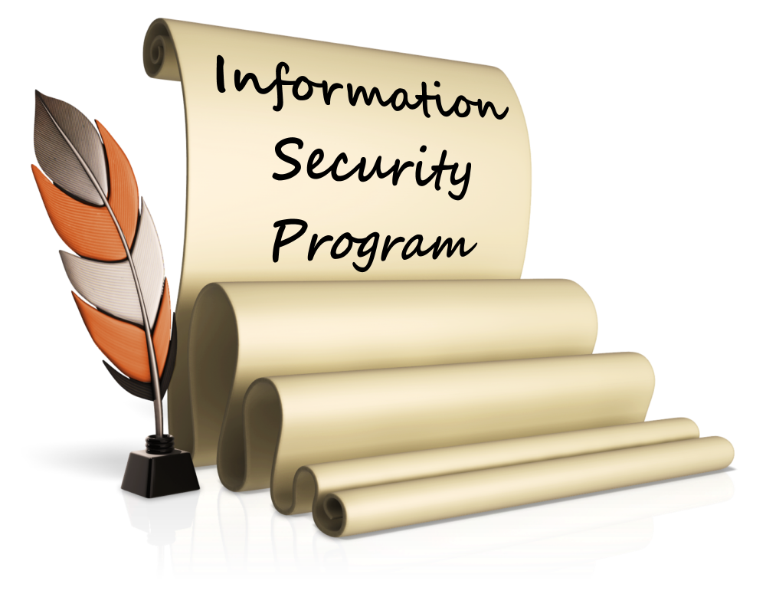
Information Security Program Review
Governance
Risk Identification
Risk Mitigation
Monitoring/Detection
Incident Response
Recovery
Program should include ongoing
Testing, Review and Update

Slide 18
Sample Information Security Program Elements
Access controls
Encryption
Review of security impact in any system changes
Personnel checks and reviews
Persistent monitoring
Incident response programs
Data and system continuity plans

Slide 19
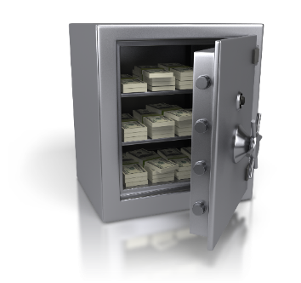
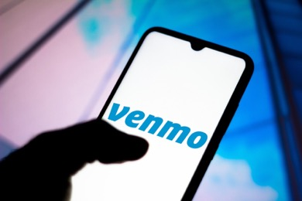
Let’s Start at the Very Beginning
Information is one of a financial institution’s most important assets
Loss (or compromise) of critical information is catastrophic
Protection of information assets is required by law and protects the institution’s reputation
From Cash To Data

Slide 20
Banking IT Evolution
Batch processing to real time processing
Custom code in house to purchased applications to outsourcing
Networking of branches and ATMs
From local to national to global—the Internet
  Online banking
  Mobile banking
New payments systems
New data driven products and decision tools
Greater reliance on automation and integration
Threats change at every stage in the evolution

Slide 21
Information Security Requirements for Banks
Regulatory guidance
Gramm Leach Bliley Act (GLBA)
Fair and Accurate Credit Transactions Act (FACTA)
FDIC 12 CFR Parts 334 and 364
FDIC Financial Institution Letters (FIL)
Resources
FFIEC IT Examination Handbooks
NIST Cybersecurity Framework
FFIEC Cybersecurity Guidance

Slide 22
Summary
Information Security and Cybersecurity definitions
CIA Triad
Elements of an Information Security Plan
Information Security Requirements and Resources for banks

Slide 23

InfoSec: The Banking and Regulatory Compliance Perspective
Chapter 3

Slide 24
Chapter Objectives
Upon completing this chapter, you will be able to
Describe the basics of the Gramm-Leach-Bliley Act
Describe the basics of the Fair and Accurate Credit Transactions Act
Discuss the concept of compliance and how it fits into security
Discuss concepts associated with governance-based procedures versus technology-based procedures
Identify several best practice considerations and references

Slide 25
What Are We Afraid Of?
Compromise of personal data
Identity theft
Personal data gathering
Lack of control of personal data use
Intellectual Property theft
Interference by a foreign power
Cyberstalking
Infrastructure damage
Any others?

Slide 26
Recent Security Events In the News
Deprioritization of CISA
Cisco Catalyst Zero-Day exploits
Marquis Software Breach
Western Alliance Bank FTP
What else has been happening?
Do you see any trend here so far?

Slide 27
Computer-Security Incidents
RMS IT and Operations Examiner Resources SharePoint site: General guidance for examinations including Risk Advisories (RAs) and Technical Examination Aids (TEAs) (FDIC-only)
  Resources for Reporting Incidents (FDIC only)
RMS IT and Operations Examiner Resources SharePoint sites: Cybersecurity News and Alerts and Reports (FDIC-only)
FFIEC Cybersecurity Awareness website. (Available to all)
Notes:
The threat information is populated by members of the FDIC team. It is recommended the resources available should be reviewed and current threats discussed at the exam. This can be part your conversation with the bank that will provide you with insight into their level of awareness.

Slide 28
Other Resources for Threat Information and General Security Awareness
Bank specific include: CISA, NIST, FBI, FS-ISAC and PCI
Government authoritative resources: DOD Cyber Exchange and National Security Agency
Security industry organizations: CIS and ISACA
There are also lots of security vendors offering insights (Cisco, Fortinet, Palo Alto, Sonicwall, Sophos and many more)

Slide 29
How Can We Protect Ourselves?
Personal responsibility
Corporate guidance/responsibility
Regulation
Threat management tools
Other?

Slide 30

Gramm-Leach-Bliley Act
An Act to enhance competition in the financial services industry by providing a prudential framework for the affiliation of banks, securities firms, and other financial service providers, and for other purposes
How old is GLBA?
How have things changed since GLBA was introduced?
How relevant is it in 2026?
Notes:
Privacy rule
Safeguards rule – updated 2023 because IT has changed so much
Pretexting provisions

Slide 31

Financial Privacy Rules
Per Section 501(b) of GLBA, effective July 2001
Each financial institution has an affirmative and continuing obligation to respect the privacy of its customers and protect the security and
confidentiality of non-public personal information
  Must have a privacy policy in place to protect the
  confidentiality of consumer information
FDIC Financial Institution Letter (FIL-68-2001)
objectives
  “Ensure the security and confidentiality of customer
  information;
  Protect personal information against any anticipated
  threats or hazards to the security or integrity of such
  information; and
  Protect against unauthorized access to or use of customer information that could result in substantial harm or inconvenience to any customer”
Notes:
Section 501(b) is the security provision of GLBA — the one directly relevant to exam work. Parse the three objectives from FIL-68-2001:
Ensure security and confidentiality of customer information: This maps to the Confidentiality leg of the CIA Triad.
Protect against anticipated threats: Banks must proactively identify and mitigate threats — not just respond after the fact.
Protect against unauthorized access that could cause substantial harm: The harm standard is customer-focused. Even if a breach doesn't cost the bank money directly, if it harms customers, there's regulatory exposure.

Slide 32
GLBA Section 501(b) Interpreted
Agencies required to establish appropriate standards for financial institutions subject to their jurisdiction that include administrative, technical, and physical safeguards, to protect the security and confidentiality of customer information. Accordingly, the Agencies issued Security Guidelines requiring every financial institution to have an information security program designed to:
Ensure the security and confidentiality of customer information
Protect against any anticipated threats or hazards to the security or integrity of such information
Protect against unauthorized access to or use of such information that could result in substantial harm or inconvenience to any customer
Notes:
CIA of PII

Slide 33
Administrative, Physical and Technical Protection Tools
Agencies issued Security Guidelines requiring every financial institution to have an information security program designed to:
Ensure the security and confidentiality of customer information
Protect against any anticipated threats or hazards to the security or integrity
Protect against unauthorized access to or use
Notes:
The armory APT
💡 A classic exam finding: a bank with strong technical controls but weak administrative controls — great firewall, but no employee security training and no process for revoking access when employees leave. All three categories must work together.

Slide 34
Compliance is Not the Same for Everyone
Some simply want to demonstrate enough due diligence to comply, avoid fines and jail
Some want higher levels of security
Most want to improve their business processes and align compliancy with the needs of their businesses
Always a trade off between the risk level and the cost of mitigation
Notes:
Motivation: bare minimum to fully embrace the dangers.
💡 For examiners: you are evaluating whether the institution's compliance approach is appropriate for its risk profile — not whether it has achieved some universal standard. A community bank in rural Kansas has a different risk profile than a money-center bank in New York.

Slide 35
FACTA Overview
The Fair Credit Reporting Act (FCRA) enacted in 1970
  Amended in 2003 to the Fair and Accurate Credit Transactions Act
FACTA allows consumers to request and obtain a free credit report each year from the credit reporting agencies
  Free reports available at www.annualcreditreport.com
Also includes rules/regulations to protect consumers against identity theft
  Consumers can place their history under review
  If fraud is suspected, an agency can place the account on alert or extended alert (7 years)
  FACTA ensures that credit agencies are disbursing credit information in a secure manner

Slide 36
FACTA Enhancements
Red Flag Rule
  New restrictions on affiliate use of consumer eligibility information
  Requirement for an Identity Theft Prevention Program that contemplates red flags
  Requirements for users of consumer reports to resolve address discrepancies
  New requirements for consumer reporting agencies to resolve disputes directly with consumers and to ensure the accuracy and integrity of the information being reported
Economic Growth, Regulatory Relief, and Consumer Protection Act
  Allows customers to freeze and unfreeze their credit reports for free
Note individual states may have stronger protections, notably CA and NY
Notes:
Red Flag Rule: Requires covered institutions to have a Board-approved Identity Theft Prevention Program. This is an active exam area.
Affiliate use restrictions: Limits how banks can use consumer information shared within corporate families.
Address discrepancy requirements: Banks must follow up when a consumer's address doesn't match what the credit bureau has on file — a red flag for identity theft.
Credit freeze rights: Consumers can now freeze and unfreeze their credit for free. Banks must have procedures for handling requests.
State variations: California and New York have stronger protections — relevant for banks operating in those states.

Slide 37
FACTA Provisions
Identity Theft Protection and Credit History Restoration
FACTA Section 114 – Fraud alerts
Covers all creditors
Requires board-approved Identity Theft Prevention Program
  Designed to detect, prevent, mitigate and respond
  to red flags
  Truncation of credit card numbers (no more than 5 digits can show)
  Needs to incorporate service provider arrangements
  Must be updated periodically with Board involvement
  Employees must be trained
Reconcile address discrepancies with the credit reporting agencies
Authenticate cardholders when a new card is requested within 30 days of an address change
Notes:
Board-approved Identity Theft Prevention Program: The board must be involved — this is not a compliance department project alone. Look for board approval in meeting minutes.
Detect, prevent, mitigate, respond: The four-part mandate. Not just detection — banks must have a response process.
Credit card number truncation: Only the last 4 (or 5) digits may appear on receipts. A straightforward technical requirement that's easy to verify.
Service provider arrangements: If a bank outsources credit card processing, the Red Flag program must extend to those providers.
Employee training: The program must include training. Ask: Is it documented? Is it effective?
30-day address change rule: If a customer requests a new card within 30 days of an address change, the bank must authenticate the cardholder's identity.

Slide 38
Red Flags Rule
Based on Sections 114 and 315 of FACTA
Red flags are patterns, practices, and activities that indicate possible identity theft
Applies to financial institutions and creditors
  How organizations must develop, implement, and administer their Identity Theft Prevention Programs
Four program elements
  Identify relevant red flags that you may come across
  Set up procedures to detect those red flags
  Respond appropriately to mitigate harm done
  Keep the program updated
Notes:
Examples Commonly Discussed in Community-Bank Examinations
A banker might encounter situations such as:
SituationWhy It's a Red Flag
Address change followed by debit card replacement requestCommon account takeover pattern
New account opened using an SSN that belongs to a deceased personPossible synthetic or stolen identity
Customer reports not receiving statementsMail diversion may be occurring
Commercial customer suddenly initiates international wiresPossible business email compromise
Multiple customers using the same address or phone numberPotential synthetic identity fraud
Login from a foreign IP followed by ACH activityPossible credential compromise

Slide 39

Part 364 Appendix B
FDIC guidelines for protecting and disposing of NPI
Involve the Board of Directors
Identify threats, assess the potential impact and assess adequacies of policies and procedures
Manage and control risk
  Design and implement an Information Security Policy
  Monitor operations
  Create response programs
Train employees
Regularly test the effectiveness of the plan
Develop information disposal plans
Oversee Service Providers
Continually evaluate and update the ISP

Slide 40
Governance-Based Procedures
An examiner determines whether an institution is providing products/services in a manner that supports compliance with the regulations (e.g., GLBA, FACTA, et al.)
Governance ensures
  Tasks are completed appropriately
  Accountability is maintained
  Risk is managed for the entire organization
Governance achieved when information security
is supported throughout the institution, from the
board to the employees
Notes:
💡 The 'tone at the top' principle applies to information security just as it does to BSA/AML compliance. An institution where the CEO dismisses security concerns will have employees who do the same.

Slide 41
Technology-Based Procedures
All the policies in the world are not effective unless there
are some technology-based protections in place
Need to define areas of focus for information technology
FDIC has a plethora of helpful tools
  Technology regulations
  Technology publications
  Cyber Challenge
FDIC participated in the development of the NIST Cybersecurity Framework

Slide 42
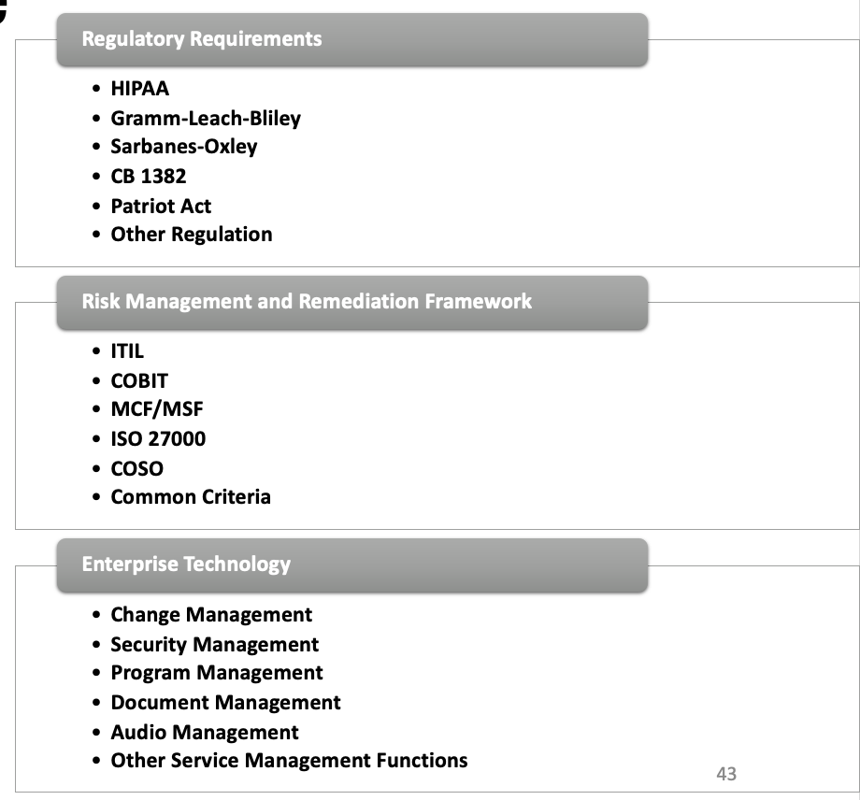
Definition of Compliance
Compliant means conforming to requirements
or instructions
Compliant does
not mean safe
Notes:
Compliant means conforming to requirements — nothing more, nothing less.
Compliant does NOT mean safe. A bank can pass every exam finding and still be breached.
This is one of the most important lessons in the course. Compliance frameworks are minimum standards — they lag behind the threat landscape, sometimes by years. A bank should use compliance as a floor, not a ceiling.
💡 Real-world example to use: Many banks that were breached in major incidents (Target, Home Depot, Heartland Payment Systems) were PCI DSS compliant at the time of the breach. Compliance is necessary but not sufficient for security.

Slide 43
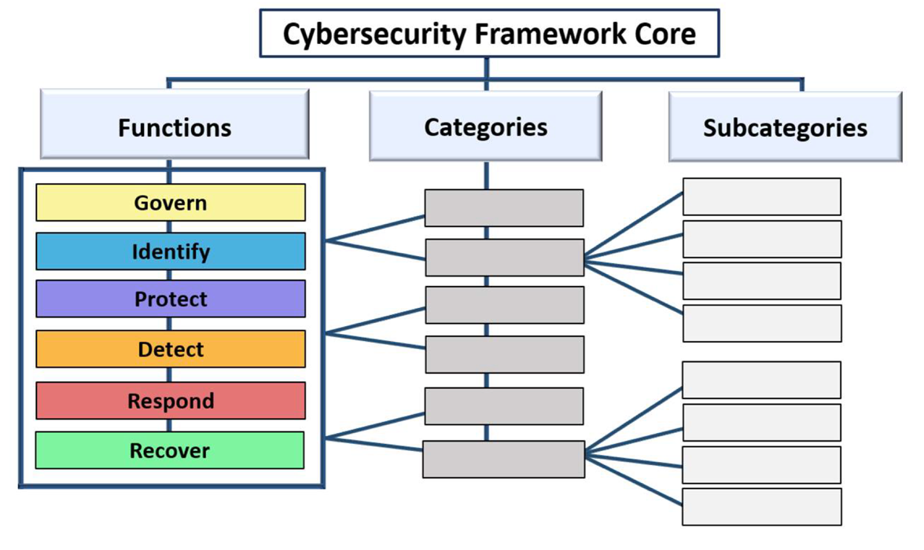
NIST Cybersecurity Framework Core
Notes:
Not a regulation, but now a de facto standard framework
What to do, not much how to

Slide 44
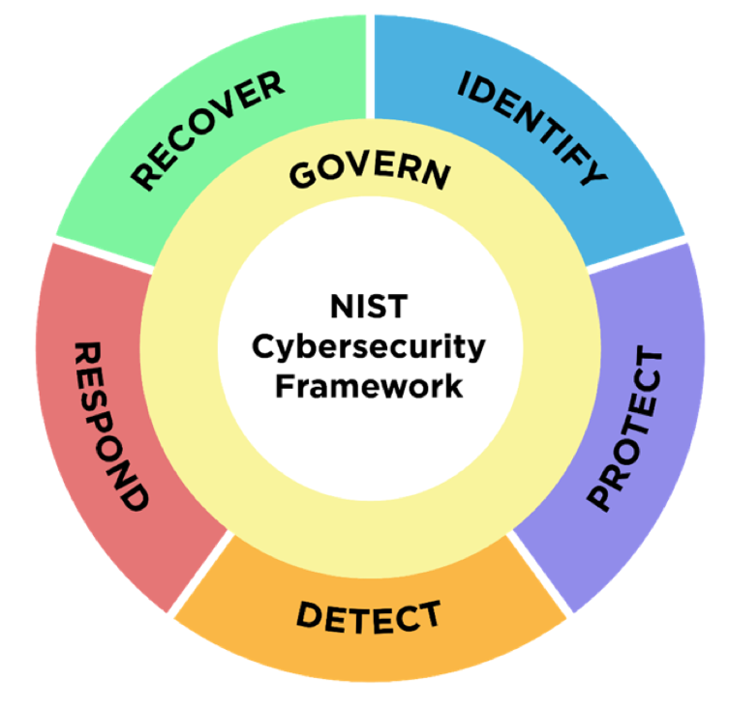
NIST Cybersecurity Framework 2.0
Released February 2024
Added Governance
Establish and monitor the organization’s cybersecurity risk management strategy, expectations and policy
Notes:
💡 For examiners: The addition of Govern to the NIST CSF reinforces the regulatory expectation of board-level engagement with cybersecurity. When you see a bank's InfoSec governance structure, you can now evaluate it against the CSF 2.0 Govern function.

Slide 45
The Six Framework Core Functions
Govern
  Outlines an organization’s cybersecurity risk management strategy, expectations, and policies; also describes how they are communicated and monitored
Identify
  Develop the organizational understanding to manage cybersecurity risk to systems, assets, data, and capabilities
Protect
  Develop and implement the appropriate safeguards to ensure delivery of critical infrastructure services
Detect
  Develop and implement the appropriate activities to identify the occurrence of a cybersecurity event
Respond
  Develop and implement the appropriate activities to act regarding a detected cybersecurity event
Recover
  Develop and implement the appropriate activities to maintain plans for resilience and to restore any capabilities or services that were impaired due to a cybersecurity event
Notes:
Govern: Establish and communicate the organization's cybersecurity risk management strategy and policies. (New in 2.0)
Identify: Know your assets, risks, and business environment. You can't protect what you don't know you have.
Protect: Implement safeguards — access controls, training, data security, maintenance.
Detect: Implement monitoring to identify cybersecurity events quickly. Time-to-detect is a critical metric.
Respond: Have a plan for when something goes wrong. Communication, analysis, containment, eradication.
Recover: Restore systems and communicate with stakeholders. Resilience — getting back to normal operations.
💡 The Respond and Recover functions are where most banks are weakest. Ask participants: in your experience, how

Slide 46
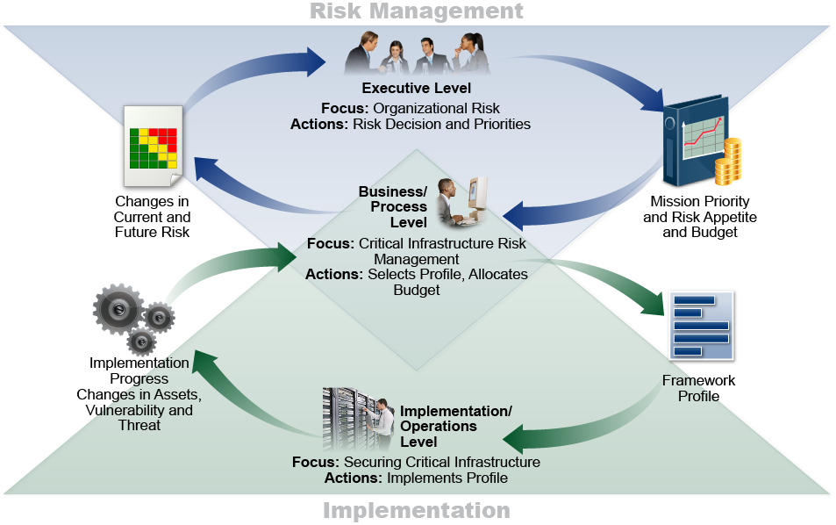
Notional Information and Decision Flows within an Organization
Notes:
cyclical not linear info flows
Each function informs the others. A new threat identified in Detect should feed back into Identify (update the asset/risk inventory) and Protect (add new controls).
Governance sits above and connects all functions — it's the management layer that ensures the cycle keeps running.

Slide 47
Uses of the Framework
Basic review of cybersecurity practices
Establishing or improving a cybersecurity program
  Prioritize and scope
  Orient
  Create a current profile
  Conduct a risk assessment
  Create a target profile
  Determine, analyze, and prioritize gaps
  Implement action plan
Communicating cybersecurity requirement with stakeholders
Identifying opportunities for new or revised informative references
Methodology to protect privacy and civil liberties
Notes:
Both for banks and examiners
Basic review: Use the CSF as a quick self-assessment tool. Where are we strong? Where are we weak?
Establishing or improving a program: The step-by-step process (Current Profile → Risk Assessment → Target Profile → Gap Analysis → Implementation Plan) is a structured approach to program development.
Communicating with stakeholders: The CSF gives non-technical executives a vocabulary for discussing cybersecurity risk. Board members can understand 'we are strong on Protect but weak on Detect' without needing technical detail.
💡 Examiners can use the CSF as an organizing framework for examination findings and recommendations. Framing findings in terms of NIST CSF functions makes them more actionable for the bank.

Slide 48
What do you see as Banking Tech Trends?

Slide 49
Summary
Overview of the Gramm-Leach-Bliley Act
Overview of the Fair and Accurate Credit Transactions Act
Dealing with compliance
Governance-based versus technology-based procedures
Planning versus doing
Best practices

Slide 50
Information Security Oversight
Chapter 4

Slide 51
Chapter Objectives
Upon completing this chapter, you will be able to
Identify the functions of IT governance and list challenges to it
Describe Information Security roles and responsibilities
Discuss common approaches to segmenting functions

Slide 52
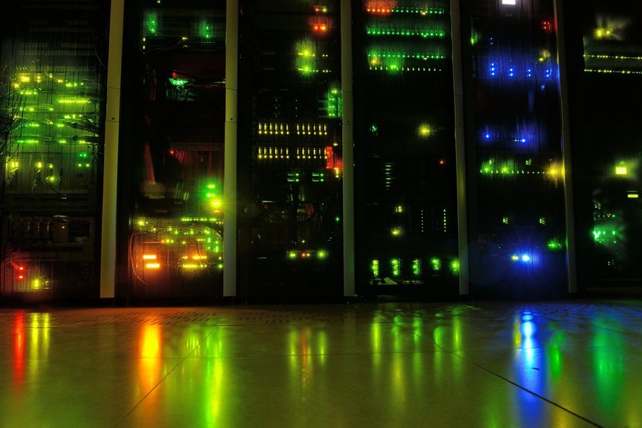
Information Technology
What are the elements of IT?
  Computer hardware
  Computer networks
  Operating system software
  Application software
  Application data
  User data
  People
  Security

Slide 53
What is IT Governance?
The Gartner Group has a simple definition
“… the processes that ensure the effective
and efficient use of IT in enabling an
organization to achieve its goals.”

Slide 54
Elements of IT Governance
Strategic alignment of IT with the business goals
IT oversight
  Project review and prioritization
  Resource management
  Budgeting
  Assigning accountability
  Lifecycle management
Risk management
Performance management
Security
Policy, standard and procedure development

Slide 55
How?
Use one, or a combination, of the many governance frameworks
  COBIT (ISACA)
  ISO/IEC 38500
  ISO/IEC 27001(security management)
  ITIL
  COSO
Size and complexity of the organization and its IT implementation determines the approach to IT Governance

Slide 56
Some Current Challenges for IT Governance
Greater reliance on IT (automation/digital transformation)
Expansion and/or replacement of the capabilities of existing IT systems
Adoption of new technologies
  Cloud
    Migration
    Containerization
    Micro-segmentation
  AI
Increased data sharing between internal applications and with partners
Managing partners (3rd and 4th parties)

Slide 57
Who Has a Role in IT Governance?
Board of Directors
CIO/CTO
CISO
LoB Heads

Slide 58

Some Things to Consider
Role of IT is expanding in most banks
Digital transformation is key to many community banks
  Gain traction with millennials
  Expand presence
  Increase speed to loan approvals
  Reduce costs?
Challenges of preventing/managing shadow IT
Availability of skilled personnel

Slide 59
Summary
IT Roles and Responsibilities
Inhouse deployment and outsourcing

Slide 60
Information Security (InfoSec) Fundamentals
Chapter 5

Slide 61
Chapter Objectives
Upon completing this chapter, you will be able to
Describe the foundations of security
Identify risks and threats for data
Discuss alternatives for handling risk

Slide 62

What are We Afraid Of?
Compliance
Data loss
  Sensitive information (customer or supplier)
  Intellectual property
Financial loss
Reputation loss
Recovery time

Slide 63

A Few of the Threats
Fraud
IP address spoofing
Automated scanning tools
Trojan horses
Bots and botnets
Packet sniffers
Viruses and worms
Java and ActiveX
Hacked web pages
Insider compromise
Mistakes

Slide 64
Enterprise Security Evolution
1980s focus on the physical protection of information
1990s CIA and consideration of insiders as well as outsiders
2000s risk analysis, proactive monitoring, incident response
2010s automation, deep packet inspection, security as a service
2020s more automation, multiple solutions combined, artificial intelligence

Slide 65
Security Breach Components
Prize
Actor
Asset
Attribute
Action

Slide 66

Actor
External
  Hacktivist
  Nation State
  Criminal
Internal
  Malicious
  Accidental
Partner
  Malicious
  Accidental

Slide 67

Asset
Stored data
  Online
  Offline
User application
Device operating system
Device
  Server
  PC
  Tablet
  Smartphone
Corporate network
Internet
People

Slide 68
Attribute
Integrity
Confidentiality
Availability
Notes:
Breach of which is hardest to detect?

Slide 69

Action
Malware
Hacking
Social engineering
Misuse
Physical breach
Error
Environmental

Slide 70

Application of Security Services
Security is needed by everyone, everywhere
Examples include
  Employees working in any part of the corporation
    Offices (branch, regional, headquarters)
    Data centers
    Stores, manufacturing locations, etc.
    Remotely (mobile workers)
  Corporate servers and critical systems
  Cloud services

Slide 71
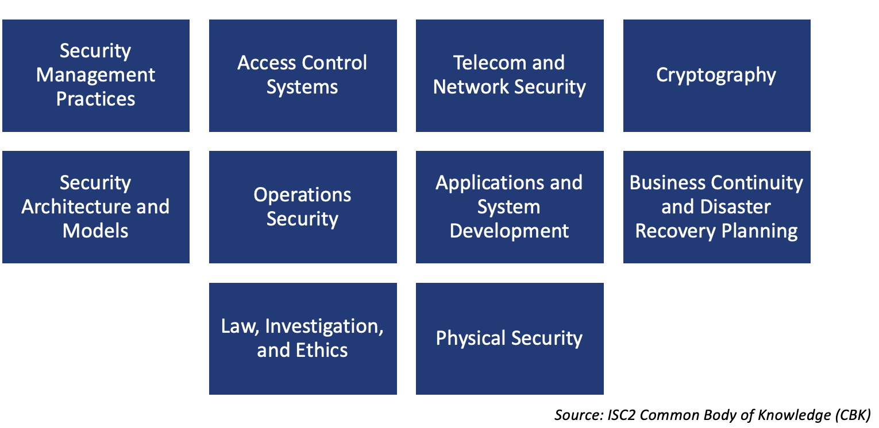
Security Topics

Slide 72
Security Definitions - Review
Vulnerability
  Hardware, software, or operational deficiency (bug) that provides opportunity for threat
Threat
  A danger to security (confidentiality, integrity, availability)
    Anything from an employee mistake to a fire
Risk
  Likelihood of threat taking advantage of vulnerability
Exposure
  The harm that comes as a result of a threat taking advantage of a vulnerability
Countermeasure
  Step taken to reduce risk
  Never 100%

Slide 73
System Vulnerabilities in the Old Days
How many keys to the room?
Can I trust the people with the keys?
What about the ceiling type and air vents?
Strength of walls, door, locks?
Electromagnetic patterns?

Slide 74
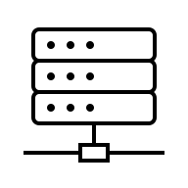
System Vulnerabilities Today
Where is the information?
Who has access?
Which networking protocols are in use?
What holes are there in desktop Operating System?
What holes are there in network Operating System?
What applications are in use and their holes?
Where are the applications located (internal, cloud)?
Are our people vigilant?
How will we detect an anomaly?

Slide 75
Cyber Kill Chain
Risks can be depicted in a variety of ways
  Event trees
  Attack trees
  Cyber Kill Chain
  And others
Tools depict multi-phasic nature of attacks
Highlight potential areas for mitigation
https://www.lockheedmartin.com/en-us/capabilities/cyber/cyber-kill-chain.html
Notes:
Used for:
1. Defensive Strategy
Instead of just reacting to malware, defenders map controls to each phase.
Goal: Break the chain as early as possible (ideally at Reconnaissance or Delivery).
2. Threat Intelligence & Detection
Security teams use the model to analyze attacks and build detection rules.
Example: If you see unusual scanning → high chance of Reconnaissance phase.
3. Incident Response
Helps responders understand where an attacker is in the chain and what they will do next.
4. Security Architecture
Modern tools are often designed around the Kill Chain:
Email security (Delivery)
EDR/XDR (Exploitation, Installation, C2)
Deception tech (honeypots)
SOAR platforms

Slide 76
Mat Honan Hacked
“In the space of one hour, my entire digital life was destroyed.”
  Google account taken over, then deleted
  Twitter account was compromised and used to broadcast
  socially unacceptable messages
  AppleID account broken into and used to remotely erase
  all of the data on his iPad, iPhone, and MacBook
Vulnerability: all accounts were
daisy-chained together
The flow of the hack
  Begins with Amazon
  Which leads to AppleID account
  Which leads to Gmail
  Which leads to Twitter
Countermeasures not used: Two-factor authentication and frequent backups (especially irreplaceable family photos)

Slide 77
The Hack and Hacker Exposed
Phobia, the hacker, communicated with Mat Honan
It all begins at Amazon with a displayed partial credit card number (last four digits) that is used at Apple as part of customer identification along with a billing address
Hacking into Amazon was easy
  Call Amazon, identify yourself as account holder and ask to add a credit card
  Amazon wants name, billing address, and email address (all of which can be found on most personal websites)
  Input a new credit card number (valid fake card numbers can be obtained online)
  Hang up and you are done with the first part
  Now call back and tell Amazon that you have lost access to your account
  Using the ID information from the last call you can add a new email address
  Go to the website and request a password reset and it will come to the new email address
  Log in with the new password and get the last 4 digits of the credit cards on file
  Go to Apple with the credit card digits and you are home free

Slide 78

Phishing is the #1 Attack Approach
Do you have any good examples of fishing?

Slide 79
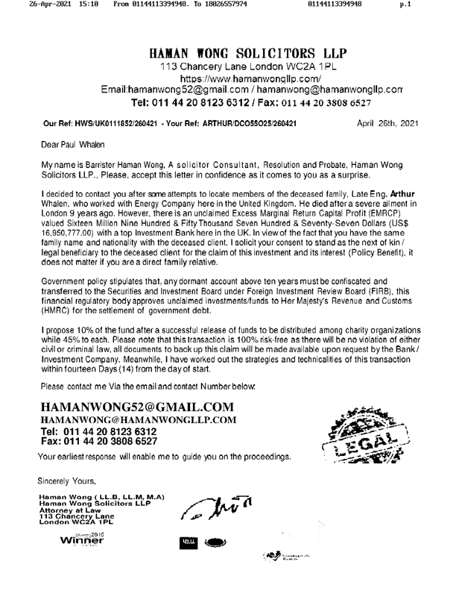

Slide 80

Information Security Tools
Physical controls
  “I am physically securing the asset…”
  Doors, locks, keys, fences
Administrative controls
  “I am telling you…”
  Policies
    Security
    Acceptable use
  Staff screening and training
Technical controls
  “I am implementing technology to control…”
  Firewalls and intrusion detection/prevention systems
  Authentication systems

Slide 81
Summary
The fundamentals of InfoSec
The CIA Triad
Sample threats and vulnerabilities
  POS breach
  DDoS attack
  Phishing
Understanding risks and threats
Handling risk

Slide 82
Security Policy
Chapter 6

Slide 83
Chapter Objectives
Upon completing this chapter, you will be able to
Define the need and purpose of a security policy
Examine the steps in security policy development
Describe how to implement an effective
security policy

Slide 84

CEO Questions
How are we identifying risks and handling them?
Are we adequately protecting the sensitive data?
What is our ability to mitigate the risks?
Do we fully understand what information we have and its sensitivity?
How are our providers ensuring they mange their systems?
Modified from CSBS Resource Guide

Slide 85
Exercise
List the “digital crown jewels” in your personal computer world
As a group create your answers to the question below and be prepared to discuss in the larger group
Who has access to them?
How secure are they?
What risks are there to losing them?
How are you mitigating these risks?

Slide 86
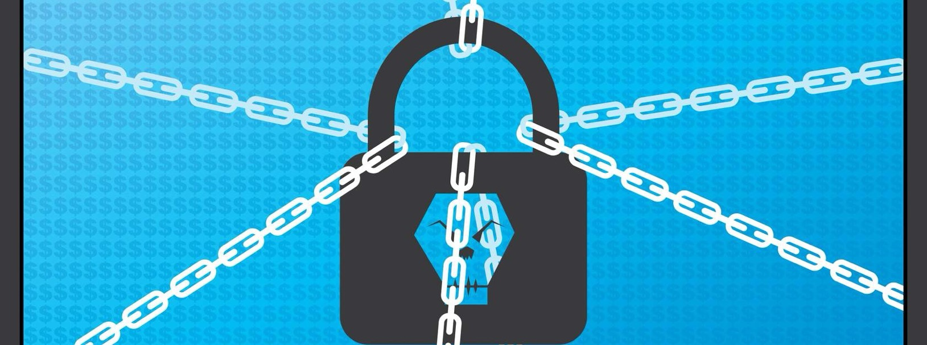
Ransomware
Will your mitigation techniques in the prior exercise work with ransomware?
Notes:
Immediately after the crown jewels exercise, hit them with this question: 'Will your mitigation techniques work against ransomware?' This is a deliberate gut-punch designed to challenge the adequacy of the controls they just identified.
Ransomware specifically targets backup solutions — modern ransomware actively seeks out and encrypts backup files before encrypting primary data. 'I have backups' is only sufficient if the backups are offline, air-gapped, or immutable.
Cloud sync (Dropbox, OneDrive, Google Drive) is NOT a backup against ransomware — it will sync the encrypted files and overwrite your clean copies.
The key question for banks: Are your backups stored in a way that ransomware cannot reach them? Offline tape, immutable cloud storage, or geographically separated backup copies are the right answers.
Recovery time matters too: Having a backup is one thing. Being able to restore from it within the bank's recovery time objective (RTO) is another. Has the bank ever tested a full restore?
💡 This is a great bridge to the importance of security policy: 'How does the bank know its backup procedures are adequate? Because there's a written policy that specifies backup frequency, retention, storage location, and testing requirements — and there's evidence those procedures are followed.' Policy is what makes ad hoc good intentions into reliable, auditable controls.

Slide 87
The Importance of a Security Policy
Policy drives technology
Increases cost-effectiveness
Provides guidelines for uncertain scenarios
(incident response)
Consistency of monitoring
Change management to ensure holes are patched
Defines acceptable use
Ensures employees are aware of the threats
Guides operations
Notes:
Policy drives technology: Purchasing decisions should follow from policy decisions. A bank that buys a SIEM without a policy requiring log review will not get the benefit of the SIEM. Technology should implement policy, not define it.
Increases cost-effectiveness: Policy prioritizes spending. Without policy, security budgets get spent on whatever vendor is most persuasive this quarter. With policy, spending follows risk.
Provides guidelines for uncertain scenarios: When the incident response team is deciding at 2am whether to shut down the core banking system in response to suspicious activity, they need written guidance. Policy provides that guidance before the crisis.
Consistency of monitoring: Policy specifies what gets monitored, how often, and by whom. Without policy, monitoring depends on individual initiative — which is unreliable.
Change management: Changes to systems must be assessed for security impact. Policy establishes the change management process that ensures security review happens before, not after, changes go live.
Defines acceptable use: Employees need to know what they can and can't do with bank systems and data. Acceptable use policy is the foundational document for insider threat prevention and response.
Ensures employee awareness: Policy is the vehicle for security awareness. You can't hold employees accountable for behaviors they were never told about.

Slide 88
Security Policy Is the “Why”
Security policy
  Short
  Stable
Supports corporate mission statement
Approval from highest level of management
Outline's consequences of non-compliance
Results in a positive cost benefit!
Notes:
💡 The 'short and stable' characteristics deserve emphasis. Examiners sometimes see banks with enormous policy documents — 200-page 'policies' that are really policy, standards, procedures, and guidelines all combined. Ask banks to show you the board-approved policy specifically — it should be distinct from the operational documents.

Slide 89
Program Policy
Sets the strategic direction for the Information Security Program
Elements include:
  Purpose of the program
    Specific focus
  Scope
    Resources covered
  Compliance
  Responsibilities
    Accountability
    Employee role
    Service Provider
  Consequences for non-Compliance
  Communication
  Update cycle
Notes:
Slide 89: Program Policy
The top of the policy hierarchy — the strategic document that governs the entire information security program:
Purpose of the program: Why does the information security program exist? Regulatory compliance, customer protection, business continuity — all of these are legitimate purposes that should be stated explicitly.
Specific focus and scope: What does the policy cover? Which systems, data, facilities, and personnel are in scope? Scope boundaries matter — if the policy doesn't cover a system, nobody is responsible for securing it.
Compliance and responsibilities: Who is responsible for what? The CISO owns the program, but business line managers own the data their lines generate. Accountability must be specific.
Consequences for non-compliance: Ranging from coaching for minor violations to termination and legal action for serious or repeated violations.
Communication and update cycle: How is the policy communicated to employees? How often is it reviewed? Who approves changes?
💡 For examiners: When asking to see a bank's information security policy, you should receive a concise, board-approved document with these elements. If the bank produces a thick technical manual, ask specifically for the program policy — the high-level governance document. They should be different documents.

Slide 90
Issue-Specific Policy
Guidance on policy addressing specific areas of concern, including:
  Internet access
  Remote access
  Email
  Software installation
Policy includes:
  Issue definition
  Organization’s position
  Applicability
  Roles and Responsibilities
  Compliance and consequences for non-compliance
  Where to get further information
Notes:
Customer WIFI
One level below the program policy — addresses specific risk areas or technology categories:
Common issue-specific policies: Internet use, remote access, email, software installation, mobile devices, social media, cloud storage, password management, incident reporting.
Internet access policy: What sites can employees access from bank systems? How is access monitored? What happens when violations are detected?
Remote access policy: Who can work remotely? What devices are approved? Is VPN required? How are remote sessions terminated when an employee leaves?
Software installation policy: Can employees install personal software on bank systems? How is unauthorized software detected and removed? This directly addresses shadow IT.
Each issue-specific policy should address: the issue definition, the organization's position, who it applies to, roles and responsibilities, consequences for non-compliance, and where to get more information.
💡 A common examination finding: banks that have a program policy but lack issue-specific policies for critical areas like remote access or mobile devices. The program policy says 'we will secure remote access' but there's no specific guidance on how. Standards and procedures can't fill this gap without an issue-specific policy to reference.

Slide 91
System-Specific Policy
Guidance on specific system security program
  Dictate security objectives for system use
  Direct operations implementation of controls
Objectives must be:
  Specific
  Clear
  Achievable
  Practical
Operations security
  What may be changed
  Conditions under which changes can be made
  Who is authorized to make changes
Notes:
ATM,
The most granular policy level — addresses security requirements for specific systems:
Examples: Core banking system security policy, ATM network security policy, online banking platform security policy.
System-specific policies answer: What are the security objectives for this system? Who is authorized to use it? What changes can be made and under what conditions? Who authorizes changes?
SCAP (Specific, Clear, Achievable, Practical): These four characteristics ensure system policies are actually implementable. Vague requirements ('systems must be secure') are unenforceable.
Operations security: The change management component. What may be changed on this system? Under what authorization? Who approves? This is the policy foundation for change management controls.
💡 For examiners: System-specific policies are where you find evidence of whether banks have thought carefully about their critical systems. A bank with a detailed, current system-specific policy for its core banking system

Slide 92

Security Standards: The “What”
Content validity measured against security policy
Quantify the risk
Refer to the risk to business and systems
that support the business
Describe the consequence of non-compliance
May refer to other standards, policies and law
(e.g., HR, federal and state laws, ISO compliance)
Protect resources
Provide secure remote access
Implement IPSec VPN
Employees
Partners
Define appropriate use
Monitor access logs
Enforce rules, punish offenders
Notes:
Standards translate policy into specific, measurable requirements:
Content validity measured against security policy: Every standard should trace back to a policy requirement. If a standard can't be connected to a policy, ask why it exists. If a policy requirement has no implementing standard, it's not actually being implemented.
Quantify the risk: Standards should be risk-informed. The standard for encrypting customer PII is stricter than the standard for encrypting internal meeting notes — because the risk of exposure differs.
Consequence of non-compliance: Standards should specify what happens when they're not met — not just that something is required, but what the remediation path is.
Example from the slide: Remote access standard requires IPSec VPN for employees and partners, defines appropriate use, requires log monitoring, and specifies enforcement. That's a standard — specific, measurable, enforceable.

Slide 93
Sample Standards
Business Continuity standard
Third Party Provider management
Cloud standard
Asset management
Access management
Physical access
Configuration management
Incident management
Information classification
Data protection standards
Data steward
Notes:
These can come from NIST, CIS, FFIEC, ISO, PCI DSS, CSA (Cloud Security Alliance) are all sources.
Many community banks don't go to primary sources at all — they use templates from their core banking vendor, their state banking association, or firms like SBS Cybersecurity or SHAZAM that sell turnkey policy and standards packages. This is pragmatic but has a meaningful risk: template standards that haven't been customized to the bank's actual environment can create a false sense of compliance. An examiner who sees a perfectly formatted standards document should ask "walk me through how this standard actually applies to your systems" — a bank that can't answer has bought compliance theater.

Slide 94
Security Procedures: The “How”
Nuts and bolts
Volatile
Content validity measured against “security standards”
The “how-to” manual of security compliance
Examples
  Roles and responsibilities
  Configuration templates
  Check logs daily
  Response actions

Slide 95
Security Guidelines: The “Best Practices”
Like standards, but not mandatory
Can be anything
But typically, refinements to either the standards or procedures, or things to consider when implementing an information security program
“Adopted” standard procedures when no formal process exists
Examples
  Connect to secure Wi-Fi only
  Do not use browser password storage features
  Don’t rush into satisfying requests for PII
  Always use strong passwords

Slide 96

Standards Enforcing Confidentiality
Physical
  Locks
  Guards
  Walls and fences
Administrative
  Password policy
  Escorted visitors
  Least privilege user accounts
Technological
  Encryption
  Authentication

Slide 97

Standards Enforcing Integrity
Physical
  Secure boots
  Employee-only network access
  Closed circuit monitoring
Administrative
  Separation of duties
  Rotation of duties
  Mandatory vacations
Technological
  Access control matrices
  Read versus write permissions
  Hash algorithms

Slide 98

Standards Enforcing Availability
Physical
  Spare component parts
  Secure backup storage
  Standby servers
Administrative
  Cross training
  Relationship with outsourcing company
Technical
  Multi-homed Internet connections
  Cloud services

Slide 99
Create Procedures Documents
Should be step-by-step documentation of security configuration
  Administrative steps
  Technical configurations and options
  Physical controls and guidelines
Multiple documents specific for each group
  Physical plant
  IT group
  HR policies, etc.

Slide 100

Review and Update Regularly
Change management is the process of defining how changes to the security policy are to be implemented.
Security policy should change only to reflect business mission
Standards and procedures might
change more often
Implement change management policy
from the start
Review after security related incidents

Slide 101
Summary
The need and purpose of a security policy
Steps in security policy development
Implementation of an effective security policy

Slide 102
Security Management Practices
Chapter 7

Slide 103
Chapter Objectives
Upon completing this chapter, you will be able to
Discuss asset management
Describe seven controls
  Access control
  Encryption
  VPN
  Firewall
  Device hardening
  Network Access Control
  Mobile device management

Slide 104

CEO Security Protection Questions
Do we have the appropriate skills and knowledge to protect against a potential attack?
Are the staff informed about cyber threats?
Do they understand the potential risks associated with their actions?
How effective are our policies and procedures for monitoring
Modified from CSBS Resource Guide

Slide 105

Asset Identification
You cannot protect it if you don’t know you have it
First step to protection is identifying what needs protecting
Inventory data may be complex
  Asset
  Value
  Location
  Manufacturer
  Configuration
  Warranty/maintenance plan
  Insurer
  Replacement options
FDIC Asset Tag 1435672

Slide 106
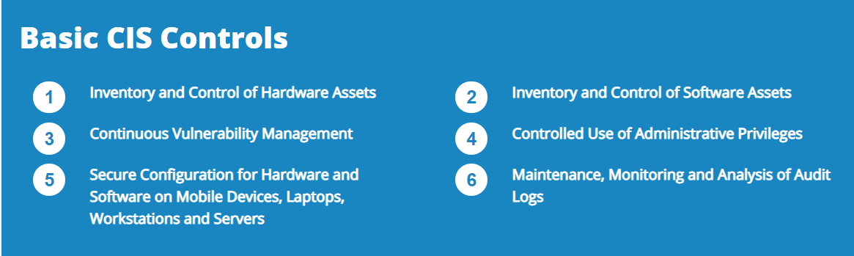
Some Asset Management Challenges
BYOD
Rogue devices
Unauthorized applications
Others?

Slide 107

Countermeasure Implementation:
A Layered Approach
Access control
Authentication
Filters
Network address translation (NAT)
Proxy servers
Virtual private network (VPN)
Firewalls
Encryption
Virus protection software

Slide 108

Access Controls
User and data classification
  Roles
  Sensitivity
Rights management
  Internal
    Onsite
    Remote
  Partner/vendor
  Customer
Technical and physical access controls needed

Slide 109

Personnel Controls
Implement checks for all employees during
Interviews (e.g., background checks)
Obtain agreements covering confidentiality, non-disclosure,
authorized use
Increased accountability (e.g., reviews)
Provide awareness training policy compliance
Post employment (e.g., disable accounts)

Slide 110


Classifying Information
Shorthand way of indicating handling and protection requirements
  Link to a protection profile
  Example: When encryption is required or physical
  controls when transporting documents
Should be clearly marked
Can change over time
  Review, update
User access controls limit who can see what
Data Loss Prevention (DLP) enforces compliance

Slide 111
User Access Control (UAC)
Maintains
Confidentiality
  Only authorized subjects can read objects
Integrity
  Only authorized subjects can modify objects
Availability
  Only authorized subjects can use objects
“Financial institutions should have an effective process to administer access rights”
- FFIEC Information Security Handbook

Slide 112
Common Terms: Part I
Objects
  Passive resources
    Files, printers, applications, system resources
Subjects
  Active entities (someone or something) that
  utilize objects
Authentication
  Identity verification
  Focus: Subject
Access controls control which objects a subject can access
Without it, everyone would be able to access everything on a network, in a database, or on a computer

Slide 113

Common Terms: Part II
Authentication
  Proving who you are
Authorization
  Access rights
  Focus: Subject → Object
Accounting
  Auditing/logging
  Focus: Subject → Object (access detail)

Slide 114
Role-Based Model
Most common model for computer operating systems
Based on subject role (group) and object class
Hierarchical strategy
  For example, security manager is in IT group, which is in employee group
Least privilege strategy
Separation of duties strategy
  No one user can abuse the system on his/her own
Users
Roles
Permissions

Slide 115
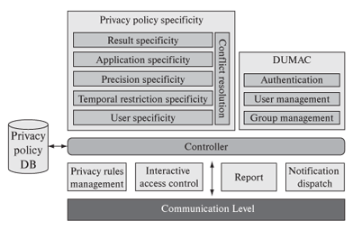
Context-Dependent Access Control
More secure than access control lists
Object access depends on subject context
  Access control lists
    Dr. Alice has read access to Bob’s patient file
  Context-dependent access control
    Dr. Alice has read access to Bob’s
    patient file only if Bob is currently a
    patient of Dr. Alice
Can also be location based (mobile)
Complex relationships mean
complex access control

Slide 116

User Access
Minimize privileges
Only use administrative accounts when needed
Audit privileged account use
Change default account passwords remove account if not needed

Slide 117

Authentication
First step in user access is identifying who they are (authentication)
Authentication requirements vary based on the user and the types of resource they have access to
Critical in limiting access to the secrets
Multifactor authentication is a must today
Optimus Prime

Slide 118

Authentication Factors
Something you know
Something you have
Something you are (biometrics)
For better authentication use multiple factors
My%Pa55Wurd

Slide 119
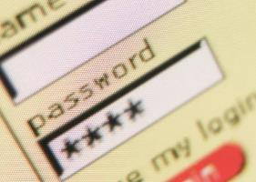
Password Considerations
Length
  Minimum/maximum
Complexity
  Capital and lowercase letters, numbers, punctuation, no dictionary words
Duration
  Expires yearly vs. monthly vs. weekly vs. daily
Scope
  Unique passwords vs. same password for
  multiple systems
Lockout after x failed attempts
Password manager anyone?

Slide 120

Biometrics
Provides authentication based on some physical characteristic
  Fingerprint (a current favorite)
  Hand/palm geometry
  Iris pattern
  Voice pattern
  Facial recognition
False negative/Type I error
  Incorrectly denying authentication
False positive/Type II error
  Incorrectly allowing authentication

Slide 121
A Conundrum
Security is important
Two factor authentication required
Customers don’t like complexity
Is it okay to trade security for simplicity in a competitive industry?

Slide 122
Third-Party Access
Who is getting in?
Consider non-employees with access
  Customers
  Vendors and partners
  Friends
  Consultants
    Part-time
  Support
    Dial-up diagnostic support
Restrict access to network resources
  Stop “shoulder surfers”
BYOD policies

Slide 123
Security Can Be Compromised Physically
Security goals can be compromised by physical access and damage
Risks typically mitigated by zone-oriented implementations
Typically focused on data centers, computers, telecom equipment
Goal: Protect against risks from
  Physical penetration by malicious/unauthorized people
  Damage from environmental contaminants
  Electronic penetration
    Actively or passively
“Financial institutions should define physical security zones and implement appropriate preventative and detective controls for each zone.”
- FFIEC Information Security Handbook

Slide 124
Secure Areas
Areas deemed critical to protect, confidentiality, integrity, and availability
Protection should be appropriate for risk
Keep logged audit trail for all access
Supervise visitors
Require visible ID
Place support services outside secure areas to
limit demands for access (e.g., fax machine, copier)

Slide 125

Material Disposal
Dispose of data carefully
  Paper
  Disks (data remnants)
Use appropriate contractor to dispose of sensitive material

Slide 126
Cybersecurity Protection
What data are we protecting?
Where is it?
How many copies of it are there?
Are all copies equally secure?
What applications use it?
Where are the applications?
Who has access to the applications?
Are elements of the data used by corporate AI applications?

Slide 127

What are we Protecting?
Cloud
internet
Corporate

Slide 128
Encryption
Encryption is simply making something unreadable without having some specific knowledge (password) or item (like a key).
Most computer encryption systems belong in one of two categories:
  Secret-key cryptography
  Public-key encryption
Why use encryption?

Slide 129

One Stop Crypto
Information to be sent or stored
Mathematical steps taken to encrypt
  e.g., DES, 3DES, AES, twofish, blowfish
  Larger key, more combinations, harder to guess (brute force attack)
Using the algorithm and a key to make plaintext unreadable
The information is sent, or stored, in an unreadable form
Convert ciphertext back to plaintext using the algorithm and a key

Slide 130
Thoughts on Cryptography
Performance impact
Hardware-based or software-based
Unfeasible to decrypt without the code
  Impractical ≠ impossible
  Strong cryptographic systems can withstand attacks up to a point
    The mathematics is rarely the weak link!
Cryptography alone cannot guarantee 100% security
  Can achieve a high level of risk acceptance
  Goal is to balance the possible with the acceptable

Slide 131
Secret-Key Cryptography
Each computer gets a secret key (code) that it can use to encrypt a packet of information before it is sent over the network to another computer
Secret-key cryptography is essentially the same as a secret code that each of the two computers must know in order to decode the information
The code provides the key to encoding and subsequently decoding the message
How do you share the secret key secretly?

Slide 132
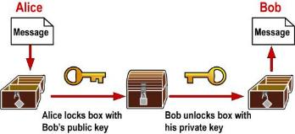
What is a Public Key?
Two keys that are mathematically related but knowledge of one key does not yield (easy) knowledge of the other
One key encrypts; the other key decrypts
Main uses: Key exchange, digital signatures, authentication
Examples
  Rivest, Shamir, Adleman (RSA) – prime factors of large number
  Diffie-Hellman (DH/DSS) -- exponentiation
Problem: How do we exchange secret keys securely?
Answer: Use a public key

Slide 133
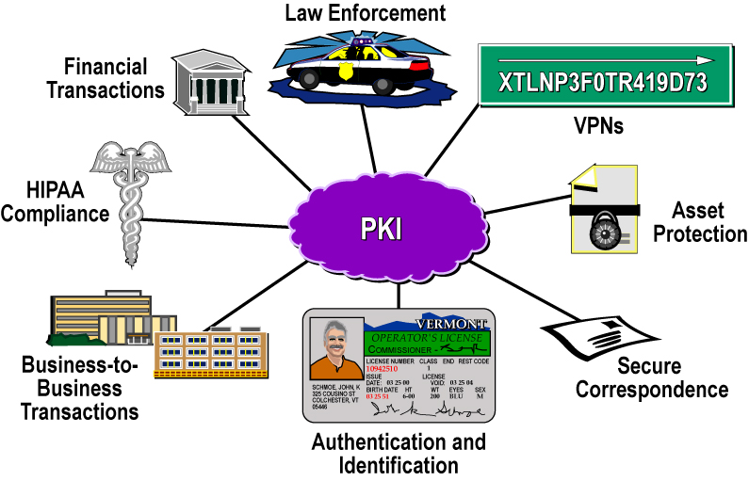
Why Public Key Infrastructure?

Slide 134
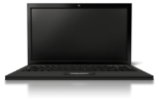
PKI Infrastructure Overview
Certificate Authority
Directory Server
Issues, Signs,
Revokes,
and Manages
Certificates
Issues Copies of
Certificates and
Certificate
Revocation Lists
Network
Users
(Client Software Employing Certificate Technology)

Slide 135

Certification
Binding an identity with a public key
3048 0241 00C9 18FA CF8D EB2D EFD5 FD37 89B9 E069 EA97 FC20 5E35 F577 EE31 C4FB C6E4 4811 7D86 BC8F BAFA 362F 922B F01B 2F40 C744 2654 C0DD 2881 D673 CA2B 4003 C266 E2CD CB02
=

Slide 136
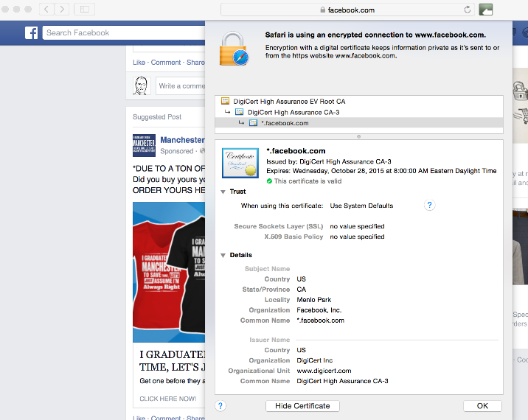
Certificate Example

Slide 137

PKI Operational Considerations: Disaster Planning and Recovery
Keep user base on record for easy notification
Configure client software to check revocation lists
Use keys of shorter duration (1–2 years) to minimize damage from single key compromise
Use key rollover mechanisms to ease recovery

Slide 138
Quantum Computing and Cryptography
A new way to solve certain problems at unprecedented speed
Cryptography is susceptible due to the approaches used in public key cryptography
Potentially our secure data can be cracked wide open
Post-quantum cryptography has been worked on and demonstrated in recent years
  NIST published standards in August 2024
Minimally it is time to plan for the age of quantum computing

Slide 139

Passkeys
Ready to eliminate passwords?
Fast ID Online (FIDO Alliance) is a step to this goal
  Support from all major OS and browser providers
  Introduced late 2022
  Adoption began in 2023
Combines identity, device, public key cryptography and biometric (or PIN) for authentication
Anyone here using Passkeys?
Any banks you are aware of?

Slide 140
Virtual Private Networks
Provide remote access to the corporate network for employees
Inexpensive option for building a private network
Allows trusted partner access to private network
AAA used for access
Public key cryptography used to exchange private session keys

Slide 141


Virtual Private Network (VPN)
Creating privacy over a public network
Provides a logical connection (tunnel) across a public infrastructure (Internet) between two devices that can be encrypted and authenticated
VPN drivers
  Reduced cost
  Geographic reach
  Mobile workforce
  Teleworkers
internet
Secure tunnel

Slide 142




Three VPN Models
Premises
internet
Premises
Site-to-Site
VPN Client
Host-to-Site
VPN Server
Host-to-Host
VPN Client
VPN Server

Slide 143
Wide Area Networks
Wide Area Networks (WAN) connect a business’s locations

Slide 144

Private Line Networks
Old school approach to building a private WAN
Rare in 2024
Privacy provided by using dedicated point-to-point circuit from the telecommunications provider, such as a T1
Dedicated Private Line from Branch to HQ

Slide 145




Multiprotocol Label Switching (MPLS)
MPLS provides connection within a service provider’s network
Does not use the internet
VPN
VPN

Slide 146
Internet VPN WANs
Site-to-site VPNs offer a low-cost WAN approach
Used to connect branches and service providers (partners)
Large networks require lots of manual configuration
  Tedious, exacting work
  Potential for mistakes
internet
Site-to-Site VPN

Slide 147
Software Defined WAN
SD WAN fastest growing WAN technology
Developed in response to:
  Need for simplified configuration (orchestration)
  Cloud application addition/migration
  Desire for greater network visibility
  Growth in importance of digital assets drives business continuity requirements
Offers ability to create hybrid of private and VPN
  Most SD WAN implementations use internet VPNs and ditch any remaining MPLS
  Use of multiple internet service providers provides for business continuity

Slide 148
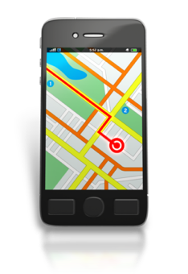
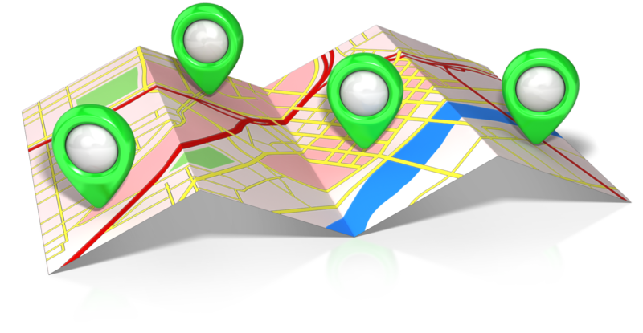
Software Defined Wide Area Networking - Concept
Centralized software control (overlay)
Multiple routes/networks
(underlay)

Slide 149
Firewall companies
Cisco Meraki
Palo Alto
Sonicwall
Sophos
Fortinet
Checkpoint
$400M, 4 branches
Find the product you think the bank should use.
Save a URL to the solution/product page.

Slide 150
Firewall Definition
A device that connects a trusted network
or device to an untrusted network.
The firewall protects the trusted network or
device while providing restricted connectivity
to and from the untrusted network,
according to a security policy
Protected
Network
internet

Slide 151
Firewall Options
Application-level gateways
Proxy servers
Application specific
Can provide user authentication
Increasing level of protection and cost
Stateful inspection
Multi-layer
Deep analysis of packet relationships
Increasing level of protection and cost
Packet filters
Network Layer
Typically implemented in routers

Slide 152
Packet Filter
Simple, powerful protection
Filter packets based on rules
  Access Control List (ACL) in Cisco terminology
IP Packet
Permit
Check
ACL
Deny

Slide 153
Stateful Inspection Firewall
Stateful inspection
Application Layer unaware
Monitors flow of TCP
UDP tracking
Allow outbound Port 80 connections
Block outbound Port 80 connections
Active Connections
Source IP | Source Port | Destination IP | Destination Port

Slide 154
Application Layer Inspection
Also known as application-level gateway
Typically occurs in application-specific device
Examples
  Email antivirus
  Content filtering
Originally standalone devices based on the application
Today part of a multi-featured firewall
May be physical device on site or hosted in the cloud

Slide 155
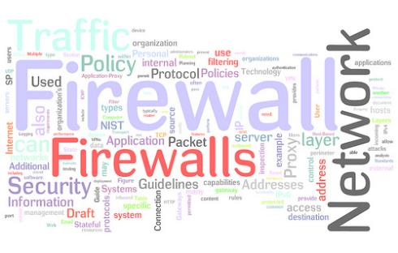
Prudent Policy
Easier to identify what is allowed than what is not
Clearly identify what is supported
  Security policy
  Applications supported by business
    To customers
    To vendors
Block everything else!

Slide 156
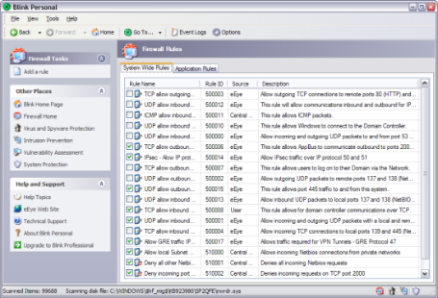
Block the Not So Obvious
From outside
  Source address should not be yours, private, unallocated, or broadcast
From inside
  Source address should be your allocated block, period
Others
  Block source routed frames

Slide 157


Demilitarized Zone (DMZ)
Part of a network that allows controlled access from the Internet
  More controlled than open access
  Less controlled than private network
Web servers and mail servers often placed here
  Referred to as sacrificial
  servers

Slide 158

Security Zones
Demilitarized zones are used as a buffer between the trusted (internal) network and the untrusted network (Internet)
Internal network maybe further segmented into security zones, segmentation based on:
  Application (voice versus data)
  Function (teller versus wire transfer)
  Wired versus wireless (may include segmenting internal and guest network)
A variety of technologies can be used:
  Physical device/network separation
  Logical separation (VLANs)
  Firewalls may be used between zones

Slide 159
Firewall Reality Check 2026
Multifunction capabilities now the norm
  Unified Threat Management (UTM)
Implemented in hardware or software
On premises or hosted
Usually, comes with ongoing threat update/monitoring service
Online portal provides clean view of incident logs
Maybe a managed service

Slide 160
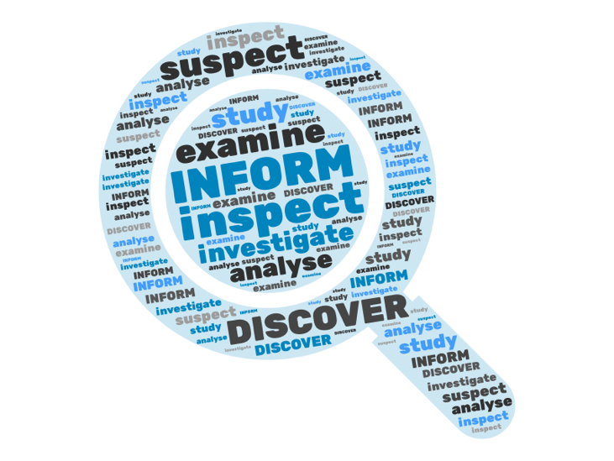

Increased Detection Capabilities
Cloud based threat identification
Machine Learning/Artificial Intelligence
UTM/Firewall

Slide 161
Virtual Network Services
Virtualization can be applied to network functions (VNF)
VNS offers a wide range of capabilities
Hosted and/or on premises
Flexible, scalable and cost-effective
Routing
Firewall
VPN
OS
OS
OS
Hypervisor
Hardware

Slide 162



Secure Access Service Edge (SASE)
Term coined by Gartner in 2019, grown in importance with digital transformation
Use varies by vendor, but there are many common elements
S
A
S
E
SD WAN
Cloud
ZT
SWG
Corporate
FWaaS
internet

Slide 163
Zero Trust Access
Access controls are a critical part of a security plan
Remote access involves Authentication, Authorization and Accounting
Traditional VPN connects you to the corporate network and assumes you are you after authentication and provides full access
Zero Trust places additional protection to key resources
Creates a model of normal workflows and may identify threats by identifying suspicious behaviors (machine learning)
A fast-developing area

Slide 164
Secure Web Gateway (SWG) and Firewall as a Service (FWaaS)
Similar, but different maybe combined in a single solution
SWG is a layer 7 device protecting the enterprise
  Application aware
  URL filtering
  Antivirus/Anti-malware
  Data Loss Prevention (DLP)
  DNS threat prevention
FWaaS (aka NGFW, WBFW) also includes
  Deep Packet Inspection
  Traditional FW capabilities
Terminology is confusing and inconsistent, do not be afraid to ask what they mean by a term.

Slide 165

Security as a Service
Individual, or comprehensive sets, of security capabilities may be provided in the cloud as well as on premises
Services may protect services in the cloud, on premises, or the entire enterprise
Hybrid premises and cloud approaches may also be found

Slide 166

Baseline Configuration
Establish and maintain baseline configurations for all device types
Implement automated (controlled) patch management scheme
Limit admin rights on on systems
Store master images offline

Slide 167
System Hardening
A process of securing a system by reducing its surface of vulnerability
System hardening works to reduce the number of functions a system can perform
Since “out-of-the-box” systems are designed for ease of use, and not security, measures must be taken
Removing non-essential software
Addressing “back-door” access issues
  Depending on the operating system, manufacturer of the software
File system access
Access audit trails

Slide 168
Sample System Hardening Checklist
Most system hardening efforts follow a generic process
Perform initial system install
Remove software that is not likely to be used
Disable or remove unnecessary usernames and passwords
  Always change the default password
Disable or remove unnecessary services
Apply security and functionality patches
Load security agents

Slide 169
Network Access Control
Designed to protect enterprise networks from the Internet
  Can also provide protection from malware that may be living on mobile devices
NAC places a virtual shield around a network by guarding its endpoints
Complex endpoint security programs use NAC to grant authenticated access to user devices
  Validating user credentials
  Scanning the device for policy compliance
NAC elements may include approved operating
systems, firewalls, VPN, current anti-virus software
May be part of a Zero Trust solution

Slide 170
Portable Devices
  Laptops
  Phones
  Tablets
Convenience primary driver
Security a major challenge
  Device
  Application
  User

Slide 171
The Enterprise Challenge
Corporate issued devices only
BYOD
Combination
Bring Your Own Device (BYOD) a struggle for CIOs
  Allows convenient access for employees to corporate data sources
  Expensive devices provided by the employee
  Creates potential security challenges
    Corporation does not own or control the device
    Hard to enforce security policies if you do not own the device
    Malicious applications growing

Slide 172
The Need for Mobile Device Management
Mobile device management requirements are similar
to other device types, you require
  Strategy
  Policies
  Monitoring
Compliance requirements growing as government agencies adapt requirements to incorporate mobile devices
Need to manage the devices as corporate assets while controlling the data and applications that run on them

Slide 173
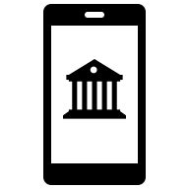
Mobility and Banking
Mobile banking
  View account balances
  View transaction history
  Initiate account transfers
  Remotely deposit checks
  Pay bills
  Locate branches
Mobile payments
  Initiate payments with mobile device
    Point of sale terminal
    Person to person

Slide 174
Summary
Asset management
Access control
Encryption
VPN
Firewall
Device hardening
Network Access Control
Mobile device management

Slide 175

Vendor Management
Chapter 8

Slide 176
Chapter Objectives
Upon completing this chapter, you will be able to
Describe the motivation for engaging a vendor
List some considerations for three vendor types

Slide 177



Outsourcing
Common approach in banking
Banking applications just one piece of the puzzle
General business applications also third-party provided
Concerns:
  Cybersecurity
  Reputation
  Business continuity
  Regulatory observance
  Confidentiality
Tools
  Non-disclosure agreement (NDA)
  Service level agreements (SLA)
  Access to vendor audit results

Slide 178

Why Outsource?
Can be a cost-effective solution
  Preserve capital
  Reduce operational expenses
Access to scarce skilled resources
  IT resources are expensive and in demand
  Hard for a community bank to attract and maintain
Allows focus on the core business, not the chore business
  Responsibility stays with the bank
  Day to day items like patching move to the provider

Slide 179
Cloud Service Model
Colo
IaaS
PaaS
SaaS
Access Controls
Application
Application
OS
OS
Hypervisor
Hypervisor
Hardware
Hardware
Facility, power, rack, environment controls, fire control
Responsibility
Customer
Provider

Slide 180
Cloud Reality
Maintaining private data centers is complex and expensive
Cloud service provider scale can offer significant savings
Businesses have many applications in the cloud
  Microsoft 365
  Salesforce
  Corporate website
Many businesses are migrating some, or all, of the remaining applications to the cloud
Typically a multi-year multi-cloud initiative
FDIC DIT is a case in point

Slide 181
Security Concerns with Cloud Migration
Concerns are generally the same as for internal systems but become more complex as a 3rd and possibly 4th party are involved
Key areas to examine
  Handling of sensitive data
  Access management
  Cloud configuration
  Data backup and replication
  Cloud service provider (CSP) security risks
  Definition of CSP and bank roles and responsibilities
  Encryption
  Contract exit criteria and terms

Slide 182

Generative AI
A form of AI
Capable of creating new content from existing data
Machine learning used to create the learning model
Generative network and transformers generate new realistic output
Many examples including ChatGPT
Content forms can include text, images, music, audio, video and computer code

Slide 183
Large Language Models
Used in GenAI
Trains on massive amounts of data
  570 GB in ChatGPT
  750 GB (1.56 trillion words) in Google Gemini
Generates new content
Learns patterns and predicts what follows based on the model
Systems starting to look at multiple predictions before providing answers (intelligence?)

Slide 184
Business Applications of GenAi
Content creation and marketing
Customer support
  Chatbots
  Email automation
Software development
  GitHub Copilot
  CodeWhispers
Financial transaction analysis
Loan decision making
Compliance testing
And…

Slide 185
AI Security Concerns
Exposure of sensitive data
Bias in the data and decisions
Misinformation
Use in cybersecurity attacks
  Phishing
  Deep fakes
  Data poisoning
Copyright and Intellectual Property violation
Compliance

Slide 186

Use Cases for GenAI in Banking
Loan and mortgage processing
Anti-Money Laundering (AML)
More precise identity verification
Automated customer support
Risk management
Enhanced cybersecurity

Slide 187
Things to Consider
How is AI being used?
Are they managing risk? (Do they use the NIST AI Risk Management Framework or some equivalent)
Do they have AI policies? Are employees aware of these policies and what they mean? (training)
Are the tools unbiased? How is this tested?
How is sensitive data (e.g., PII) protected?
Is the AI autonomous or is there human oversight?
Anything I missed?

Slide 188
Telecommunications Provider (Carrier)
Private data, Internet and voice services
Contracts vary significantly from provider to provider and by service
Know your vendor
Things to look for:
  Data encryption
  Business continuity options
  Security offerings
  Service monitoring (provider and customer options)
  Outage notification
  Filing a claim

Slide 189
IT/Phone Provider
Many businesses use local IT and phone vendors
Support the community
Things to look for:
  Industry skills
  IT/Phone skills
  Certifications (past, ongoing)
  Reputation
  Availability
  Knowledge of compliance requirements
  Monitoring services

Slide 190
Summary
Motivation for engaging a vendor
Considerations for three vendor types

Slide 191
Monitoring and Incident Response
Chapter 9

Slide 192
Chapter Objectives
Upon completing this chapter, you will be able to
Describe Intrusion Detection and Prevention
Discuss Security Team principles
Discuss incident responsiveness

Slide 193

CEO Detect Questions
Are we prepared to limit the damaged caused by any attacks?
How is executive leadership informed about current security risks to our company?
Modified from CSBS Resource Guide

Slide 194

Ongoing Monitoring
Protect provides the tools to repel attacks
Attacks are continually evolving and morphing
Detection tools proactively monitor to identify anomalies
Generating and reviewing data is essential
Identify who needs to know in case of an event

Slide 195

Intrusion Detection and Prevention
Acts on activity at the edge or inside the network
  Presumes peripheral defenses breached
  Or activity originating from inside
Intrusion detection system (IDS) identifies
unauthorized or unusual access and then alerts
based on severity
Intrusion prevention system (IPS)
as well as alerting also acts immediately
on stopping the activity
Today functions hard to separate in UTM solutions

Slide 196
Host-Based vs. Network-Based IDS
Host-based
Network-based
Protects individual servers
Usually protects against accidental or malicious actions
  File deletion
  System configuration changes
  File manipulation
Includes monitoring and processing
  CPU and disk usage
  Syslog
  Event logs
  Potential for trail to be covered
Monitors a network or LAN segment
  Requires sensors in promiscuous mode
  Monitors traffic to detect attacks or other suspicious activity
Does not require per host configuration
  A plus where servers belong to different departments
  Effective ROI
  Not dependent on host integrity for operation

Slide 197
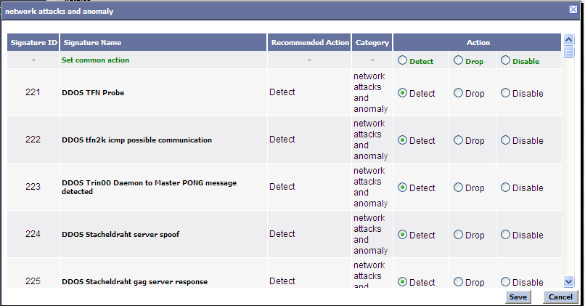
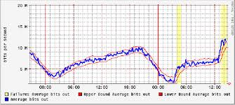
Signature- vs. Statistical-Based
Signature (knowledge-based)
  Relies heavily on a database of known attacks and anomalies
  MUST be kept up-to-date
  Cannot detect what is not in database
Statistical (detects anomalies)
  Baseline sample of what is normal
  Deviations are suspicious
  Can protect against unknown attacks
  Helps in Day 0 attack vectors
  Uses machine learning (ML) and artificial intelligence (AI)

Slide 198

Managing the IDS
This can be complex; nothing is perfect
Filtering false positives
  False alarm → noise
  An annoying distraction
Tuning false negatives
  Missing the real thing!
  Experience will be a guide
Tracking normal behaviors (ML) and AI improve identification of suspicious activity

Slide 199
Endpoint Detection and Response (EDR)
Monitors activity at endpoints
Analyze this data to identify threat patterns
Automatically respond to identified threats
Combines
  Endpoint agent
  Cloud analysis (ML/AI as used in modern firewalls/UTM)

Slide 200
eXtended Detection and Response (XDR)
Extends the data collection and correlation across the enterprise
Integrates data from multiple sources
Improves detection of advanced threats
Provides greater awareness of security status
May lower total costs

Slide 201
Role of Network Auditing and Monitoring
Auditing is preventative
  Vulnerability testing
  Network scanning
Monitoring is detective
  Log analysis
  IDS
  File/system integrity checker
“Management should develop and follow a formal internal audit program consisting of policies and procedures that govern internal audit functions, including IT.”
- FFIEC Audit Handbook

Slide 202

Choosing an Auditing Consultant
“In-house” vs. “farm-out”
  Expertise level
  Familiarity level
  Confidentiality level
  Independent view
Important considerations
  Track record/experience
  Non-disclosure agreement
  Depth of audit
    All systems vs. subset (criticality)
    Network only vs. enterprise-wide

Slide 203
Vulnerability Testing
Know your infrastructure’s vulnerabilities
  Administrative
  Physical
  Logical/technical

Slide 204

Testing Administrative Vulnerabilities
Staff awareness
  Education
  Adherence to policy
Policy
  Understandable
  Enforceable
  Comprehensive
  Changeable

Slide 205

Testing Physical Vulnerabilities
Access
  Entry barriers
    Locks, doors, guards
  Equipment
Damage
  Man made
    Access controls
  Natural causes
    Fire extinguishers, raised floors

Slide 206
Testing Technical / Logical Vulnerabilities
Software patching
Network scanning
Examine patch levels
  Operating system
  Applications
  BIOS/firmware
Maintain version catalog of all software
Browse vendor sites for vulnerabilities
Subscribe to auto-update feature or update notification feature
Port scanning
  Active hosts
  Well-known open ports
  Example: Nmap
Vulnerability scanning
  OS fingerprinting
  Application versions and banners
  Exploit testing
  Example: Nessus

Slide 207
Vulnerability Scanning
Scanning used to identify weaknesses
Scans can be authorized (credentialed) or unauthorized (non-credentialed)
Authorized scanning
  Uses credentials to scan deeper into the systems
  Identifies missing patches, configuration issues and weak passwords
Unauthorized scanning
  Simulates external attack
  Identifies external threats such as open ports and outdated software

Slide 208
Pros and Cons: Authorized and Unauthorized Scans
Feature | Authorized Scan | Unauthorized Scan
Access | Internal deep system access | External (surface) access
Purpose | Find application and system vulnerabilities | Simulate external attack
Capability | Patch level (OS, apps), misconfigurations, poor passwords | Open ports, exposed services, outdated software
Use case | Compliance and audit | Pen testing (external risk analysis)
Risk | Credential management, scan time | Low
Which approach should I use?
How frequently should I scan?

Slide 209
Monitoring Ethics
Difficult balance between security and privacy
Sensitive activities
  Network sniffing
  Activity logging
    Web, email, financial and healthcare sites
Legal issues
  Monitoring must be documented
    Acceptable use/privacy policy
    Login banner
    Employee education

Slide 210

Audit Reports
Executive
  High-level description of issues discovered
    May be grouped into categories
    Severity
    Consequences
    Solutions
Technical
  Detailed list of vulnerabilities and fixes
    Specific issues at OS/application level
    Appropriate patches to install

Slide 211

CEO Response Questions
What would we do if we were hacked today?
Have we created an effective response plan? How often is it tested?
Do we have a plan to inform internal and external stakeholders?
Modified from CSBS Resource Guide

Slide 212
When Things Go Wrong
Technology can only go so far in detecting attacks
  IDS, firewalls, or other management protocol signals alarm
Humans with understanding of networks must be attentive for strange (abhorrent) events
  Strange or missing files
  System crashes
  Unusual memory/CPU usage
More ways than technology to crack a network
  Phone calls

Slide 213
Security Administration Team
Need representation across departments
  Or at least input
Need clear reporting structure
  Outline responsibility
  Establish ongoing accountability
Monitors and audits security measures
IT administration
  Does not develop policy, it implements it
These members are facilitators, not necessarily the final decision makers

Slide 214

Incident Response Teams
Akin to “fire wardens”
Trained, experienced personnel in responding to incidents
Clear authority and responsibility defined
  Know who to contact when
    Members keep telephone list with them
    Interface to the media
  Have authority to make production-affecting
  decisions in management's absence
  Fill other functions within organization
  (not needed when things are going well)
Satisfies requirements of FDIC part 364
Appendix B, Supplement A, “Interagency
Guidance on Response Programs”
  http://fdic.gov/regulations/laws/rules/2000-8660.html#fdic2000appendixbtopart364

Slide 215
Incident Response Plan
Hypothetical: The server goes down! Now what?
Detect
Evaluate
  Seriousness
  Urgency
Contain
  Isolate resource
Investigate
  Might depend
  on above
Eradicate
Restore
Post mortem
Legal counsel should review

Slide 216
Incident Response
Goal is to limit or prevent damage
Includes plans for different types of attack
Maybe automated or manual
Includes communications to key parties
  Leadership
  Stakeholders
  Shareholders
  Partners
  Customers
  Insurance providers
  Regulators
  Law enforcement

Slide 217

Incident Response Phases
Prepare
Detect
Containment
  Short term
  Long term
Eradication
Recovery
Review

Slide 218

Incident Response Postmortem
Post incident is a good time to review
Lessons learned
Decision to prosecute
Update documentation

Slide 219
FDIC Incident Response Job Aid
Job aid handout outline procedures for responding to cyber incidents at FDIC supervised institutions or their service providers
Guidance also can be found using the links in the earlier slide outlining FDIC resources

Slide 220

CEO Recovery Questions
When did we last test our recovery plan?
Does the incident response plan include steps for recovery after an attack?
How will we communicate to staff, customers, partners, regulators and law enforcement?
Modified from CSBS Resource Guide

Slide 221
Recovery Plans
Specific plans required for different type of attack
Plan elements designed to:
  Isolate affected systems
  Assess damage (systems, data, operations)
  Restore of operations
  Minimize data loss
  Validate system operation
  Establish roles and responsibilities of the recovery team
  Communications plan
  Third-party (vendor) coordination
  Post incident review and plan update

Slide 222
Preparedness Audit
Auditing the preparedness plan can help ensure you are ready for an event
Elements to include
  Review and update breach response team contact list
  Review plan for completeness and update as needed to incorporate changes
  Review vendor contracts
  Review notification guidelines
  Check third party management of any data and their response plans
  Ensure access controls are in place and monitored
  Validate software patch (update) policies are effective
  Verify backup data is good and safe
  Review staff awareness
Modified from Experian Data Breach Resolution’s Breach Response Guide

Slide 223
Summary
Response plan requirements
Auditing the response plan

Slide 224
Closing Thoughts
Build a culture that is security aware
  Training
  Testing
  Communicating
Patch everything
Use strong authentication and concept of least privilege
Encrypt everywhere possible
Backup data regularly
Deploy strong perimeter and endpoint protection and detection
Segment network
Support the security of remote workers

Slide 225
Closing Thoughts IT Initiatives
Cloud migration
  Relocation of applications to cloud service provider (CSP)
  Roles and responsibilities have changed (policies, procedures, contracts)
  Governance
  Cloud security assessments
  Compliance
Use of AI
  Privacy
  Access management
  Bias
  Compliance
  Explainable, transparent AI decision making
  Update to stay current with regulation

Slide 226

Thank You! matt@hillvt.com

